Slide 1
Swarm TinyML: Enabling Decentralized Machine Learning on heterogeneous Microcontroller Networks.
Xiaoguang Guo
5/5/2024

Slide 2
Data redundancy
CPU-GPU Integrated
Architecture
Data redundancy elimination
ARM CPU
Model compression
MCUs
CPS
Hardware
Resources reallocation
Workload detection
Data
CPU-GPU co-run
Streaming-data
Data transmission
Cross devices
Distributed
On-device learning
Decentralized
Process directly without decompression
Compressed Data
Federated
Notes:
Distributed framework regular
MCUs how to communication
6iowpm bluetooth jig B limited
Target to which level MCUs
Wifi or

Slide 3
Background:
IoT ↑, MCUs
EdgeAI & AIoT: On-device learning, TinyML(Cloud -> MCUs)
Distributed learning: local learning -> FL -> swarm learning
Despite progress in decentralized and swarm learning, significant gaps persist at the microcontroller level.
Research Problem:
Can we design a data-driven, decentralized MCUs system utilizing swarm learning to solve real-world problems?
Contributions:
Swarm Learning Framework for Multi-Device Collaboration on MCUs.
Development of an Efficient Communication Protocol for Decentralized MCU Networks.

Slide 4
Smart Agriculture
Soil moisture, auto irrigation, pest activity, nutrient levels,…
Environmental Monitoring
Air & water quality, forest fires, illegal logging in remote areas
Health Monitoring
Emergency alert
Industrial IoT
Maintenance of machinery
Smart Cities
Traffic flow management
Wildlife tracking and conservation
Monitoring wildlife movements

Slide 5
Research questions:
How can swarm learning algorithms on MCUs be optimized for energy and computational efficiency in a decentralized network?
What communication protocols best support robust and efficient data exchange in intermittently connected decentralized MCU networks?
How can the network topology of decentralized MCU systems be dynamically managed to optimize learning and communication as nodes change?
What are the trade-offs between accuracy and efficiency in decentralized learning systems on MCUs?
How can machine learning models in decentralized MCU networks be dynamically adjusted in response to environmental changes?

Slide 6
System Architecture
MCUs Selection:
Sensor Integration:
Communication Infrastructure
Heterogeneous Communication System
Swarm Learning Algorithms
Algorithms Selection
Customization
Simulation

Slide 7
Communications Protocols:
Protocol | Description | MCUs Examples | Applications
Wi-Fi | TCP/IP, wide range | ESP8266, ESP32 | Smart home, IoT,
BLE | Short range, low power | nRF52840, ESP32 | Wearables
Zigbee | Mesh networking, | Xbee modules, CC2530 | Home automation
LoRa | Long range, rural areas | STM32(SX1278) | Agricultural sensors
CAN | Robust, noisy env, automative | ATmega32M1, STM32 | Automative networks
NFC | Very short range, secure | PN532 NFC, STM32 | Contactless payments

Slide 8
Begin with 3 MCUs.
Homogeneous (identical MCUs) or heterogeneous (different MCUs)?
One communication protocol or multiple protocols
Multiple tasks simultaneously or one single task distributed?

Slide 9
Communication Network Architecture
Peer-to-peer, Dynamic Mesh Topology
Nodes: ESP32
Protocols:
Wi-Fi Direct (no need Wi-Fi AP)
BLE?
Best path for data packets

Slide 10
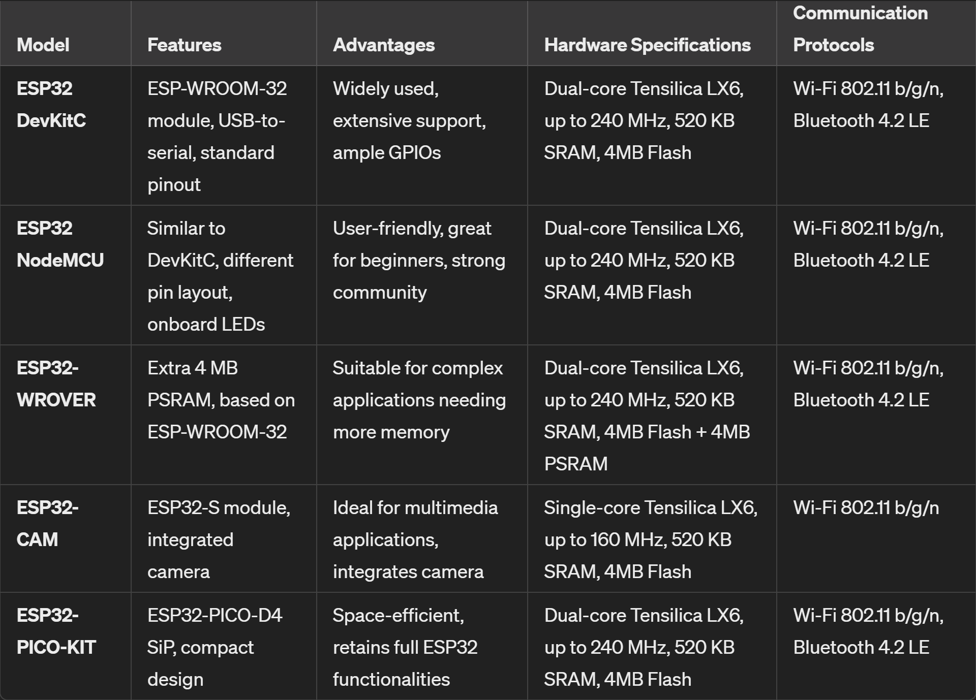
MCUs selection: ESP32-WROVER
https://www.amazon.com/gp/product/B0B3JD1K1T/ref=ox_sc_act_title_1?smid=A3S807LE0L63AP&psc=1 https://www.amazon.com/Freenove-ESP32-WROVER-Bluetooth-Compatible-Tutorials/dp/B0CJJHXD1W/ref=sr_1_2?crid=F1E4RMJ0368C&dib=eyJ2IjoiMSJ9.qRWqoY_UasjKo8Ke477M5cCkEpLxcPZqIAzXzRbPz-kVq5RbFAECDwEmGCtijln69j0TlvTjtibegiWc7lkIehlRMlnL7-UJEp_XkSgDB9whYNWhHsj-R9CdxqcuGV1IrYO6HDycrHPRSqW75PRFs_APxhMcHc7xtOMq_2E9I5bF_s-or5yihVbL9QRVQyKbtCmU5cJ4JLpJI5KJWO-52Nkx4k3YA15Gw2Tx2kA13G8.NP8mD56wBrTqJJQHvm9kXCRnOug7k8xrEhyc3TJV-pI&dib_tag=se&keywords=ESP32-WROVER&qid=1715748951&sprefix=esp32-wrover%2Caps%2C153&sr=8-2&th=1

Slide 11
Machine Learning Tasks:
Phase 1 (preloaded dataset)
Simulating real-world data distribution
Same Pre-built models on 3 devices
Existing frameworks: TensorFlow Lite, MicroML, …
Phase 2 (real-world application)
Sensors integration: Collecting data from each device

Slide 12
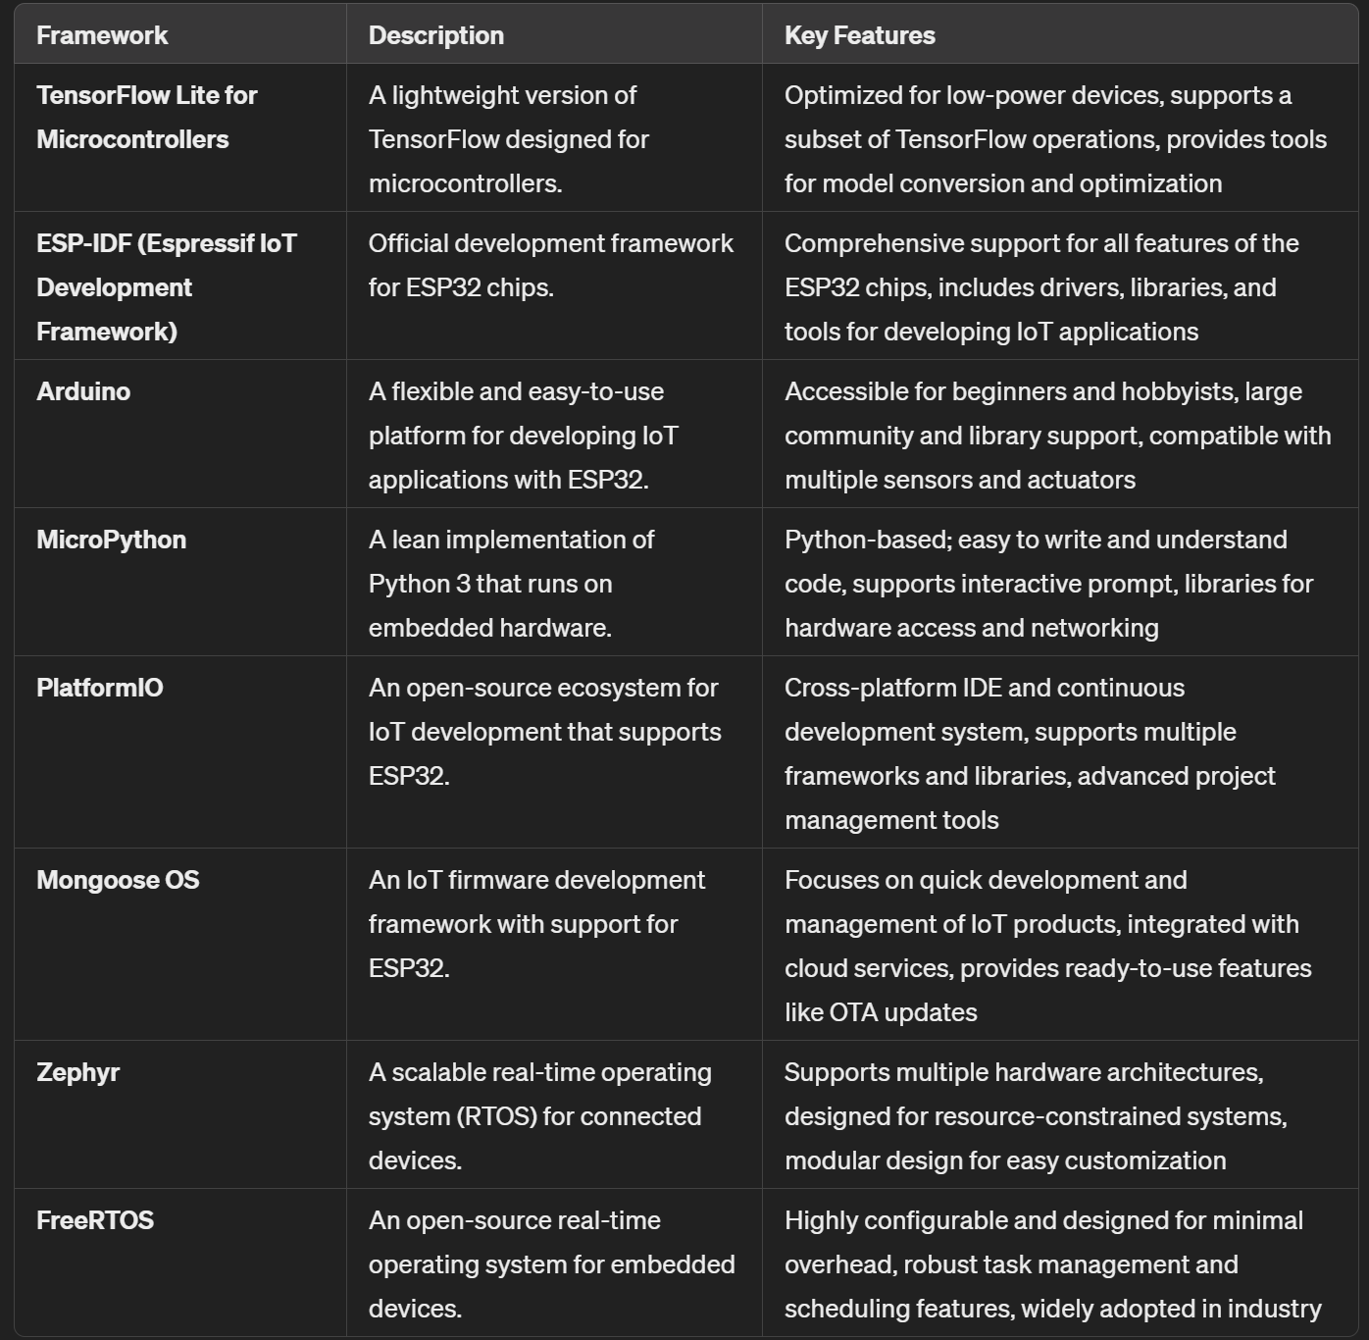
TinyML Frameworks:

Slide 13
A Systematic Literature Review on Distributed Machine Learning in Edge Computing
Table 8. EI frameworks
If applicable, decentralized learning frameworks
SWARM LEARNING: A SURVEY OF CONCEPTS, APPLICATIONS, AND TRENDS
Maybe MCUs network

Slide 14
System Requirements
Data type
Power
Communication: distances, obstacles

Slide 15
System Objectives?
Hardware
AI accelerators?
Peripheral Integration: Sensors and actuators
Power
Decentralized Network Architecture
Topology Design: peer-to-peer?
Communication Protocol: Zigbee, bluetooth, LoRa
AI and Swarm Learning Components
AI Model Development: Pruning, Quantization, model compression,…
Local Learning
Model Sharing Mechanism
Blockchain protocol
Software Development
Firmware Development: data collection, local processing, and communication
Swarm Intelligence Algorithms: collaboration and adaptation

Slide 16
Notes before May 14th, 2024
We want to evaluate both BLE and Wi-Fi.
https://www.amazon.com/gp/product/B0B3JD1K1T/ref=ox_sc_act_title_1?smid=A3S807LE0L63AP&psc=1 https://www.amazon.com/Freenove-ESP32-WROVER-Bluetooth-Compatible-Tutorials/dp/B0CJJHXD1W/ref=sr_1_2?crid=F1E4RMJ0368C&dib=eyJ2IjoiMSJ9.qRWqoY_UasjKo8Ke477M5cCkEpLxcPZqIAzXzRbPz-kVq5RbFAECDwEmGCtijln69j0TlvTjtibegiWc7lkIehlRMlnL7-UJEp_XkSgDB9whYNWhHsj-R9CdxqcuGV1IrYO6HDycrHPRSqW75PRFs_APxhMcHc7xtOMq_2E9I5bF_s-or5yihVbL9QRVQyKbtCmU5cJ4JLpJI5KJWO-52Nkx4k3YA15Gw2Tx2kA13G8.NP8mD56wBrTqJJQHvm9kXCRnOug7k8xrEhyc3TJV-pI&dib_tag=se&keywords=ESP32-WROVER&qid=1715748951&sprefix=esp32-wrover%2Caps%2C153&sr=8-2&th=1

Slide 17
Swarm learning is an overlay network.
Block chain is necessary for all current system setup.
For micro controller local network, is block chain feasible?
What kind of block chain platform or market is assumed or built on?
Distributed or decentralized on micro-controller ML learning.
Multiple local devices (who distributes IPs)
No centroid node.
Wi-Fi or Bluetooth?

Slide 18
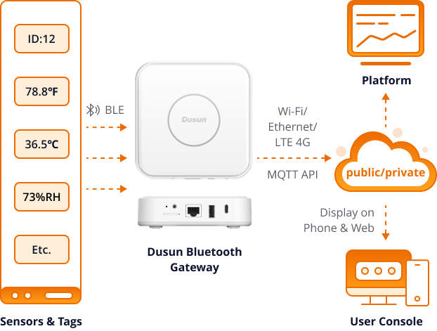
https://www.dusuniot.com/blog/bluetooth-iot-deploying-your-iot-projects-with-ease-and-low-cost/

Slide 19
Feature | Bluetooth Classic | Bluetooth Low Energy (BLE)
Frequency Range | 2.402GHz to 2.48GHz | 2.402GHz to 2.48GHz
Range | Up to 100 meters | Up to 100 meters
Data Transfer Rate | 1-3 Mbps | 125 Kbps – 2 Mbps
Communication Mode | Continuous | Short bursts
Power Consumption | Higher | Lower
Voice & Large File Transfer | Yes | No
Latency | Up to 100ms | 6ms
Power Usage | 1 Watt | 0.01 to 0.5 Watts
Bidirectional Communication | Yes | Yes
Unidirectional Communication | No | Yes
Indoor Location Tracking | Limited accuracy | Yes
Asset Management | Limited tracking capabilities | Yes
PC Peripherals Support | Yes | Limited support
Security | AES-128 encryption | AES-128 encryption

